Slide 1
My New Zealand experience 18 July – 18 December

Slide 2
Before leaving
How I was feeling?
Excited
Scared
Anxious
Weird
Sad
Confused
Why I decided to leave?
My brother gave me the idea
I wanted to become more mature and independent
For improving my english
To learn new cultures
For meeting new people

Slide 3
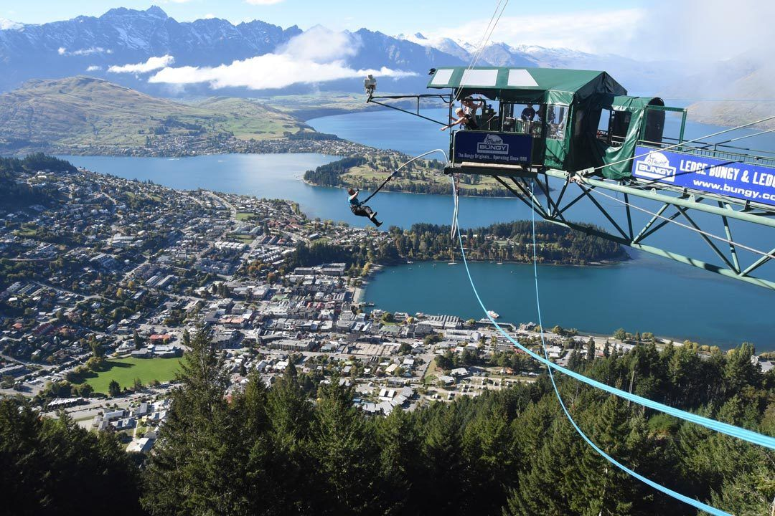
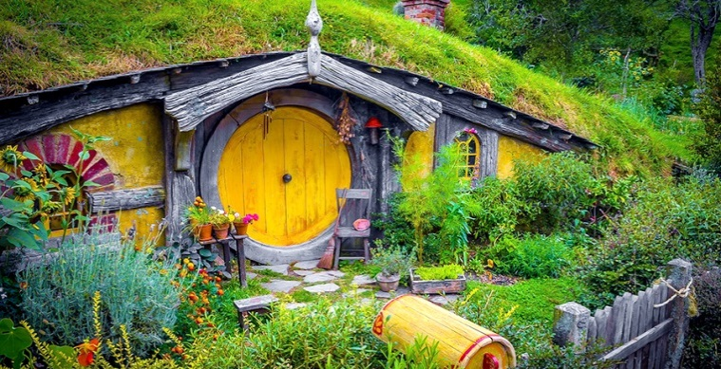
Kia Ora!

Slide 4
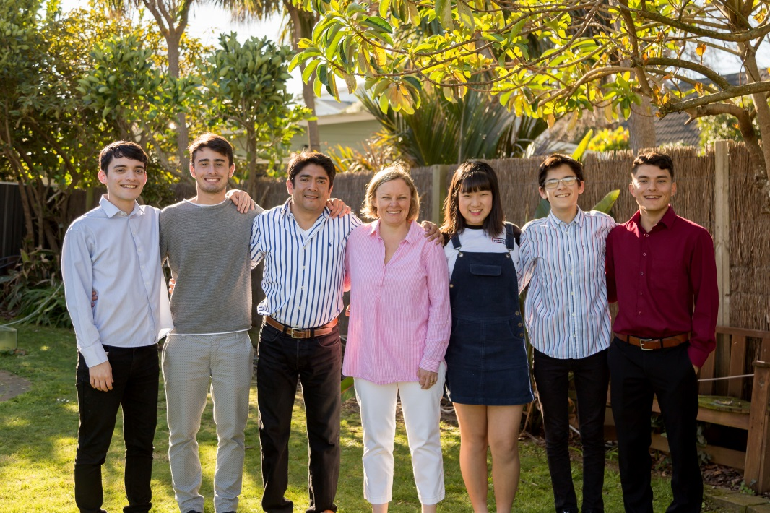
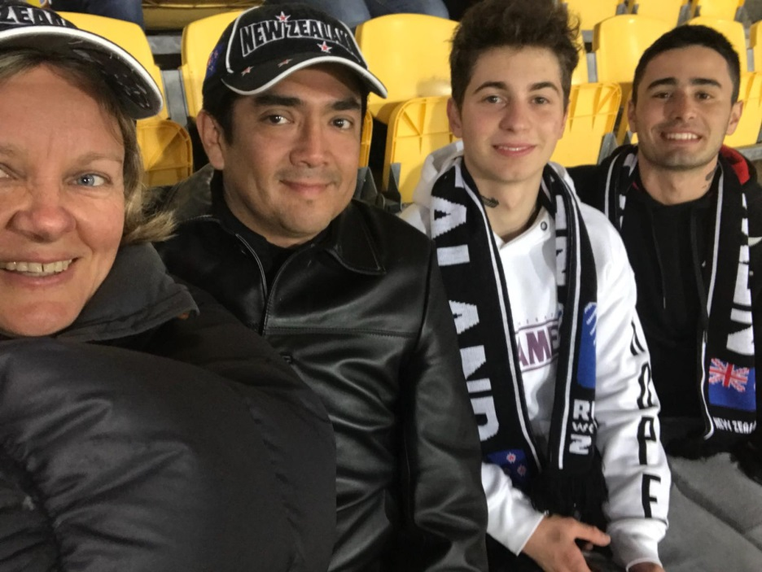
My host family
I feel so lucky to have found such a beautiful family to stay with, I couldn’t have found a better family. I immediately felt like I was involved, and I created a really good relationship with my host parents and I hope we will see each other again soon.

Slide 5
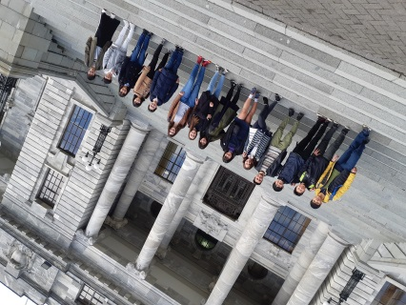
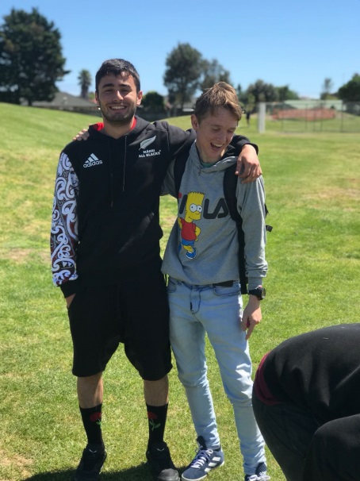
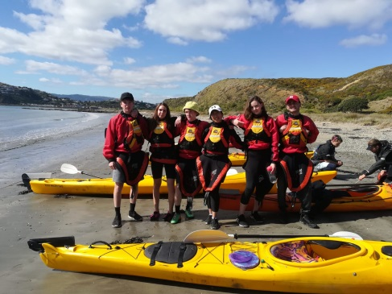
School
First days: How I was feeling? How I introduce myself? Who tried to help me?
Differences between italian school and NZ school:
Choosing 6 subjects; wearing a uniform; from Monday to Friday; lunch break; approach between the teachers and the students; doing sport for the school team etc..

Slide 6
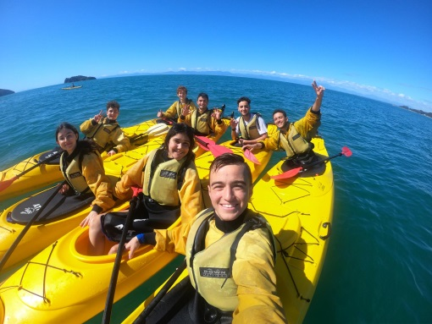
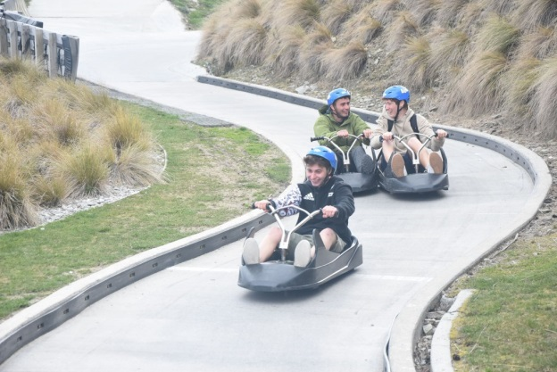
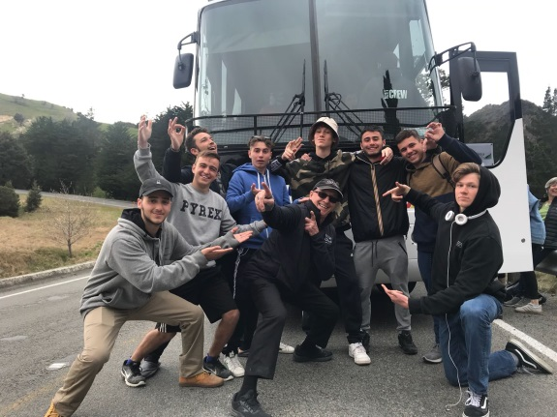
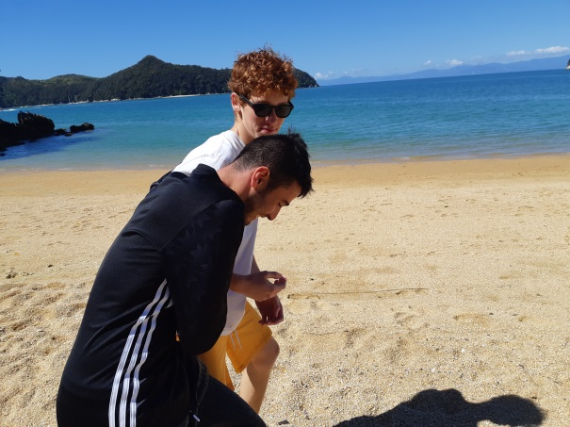
South island trip

Slide 7
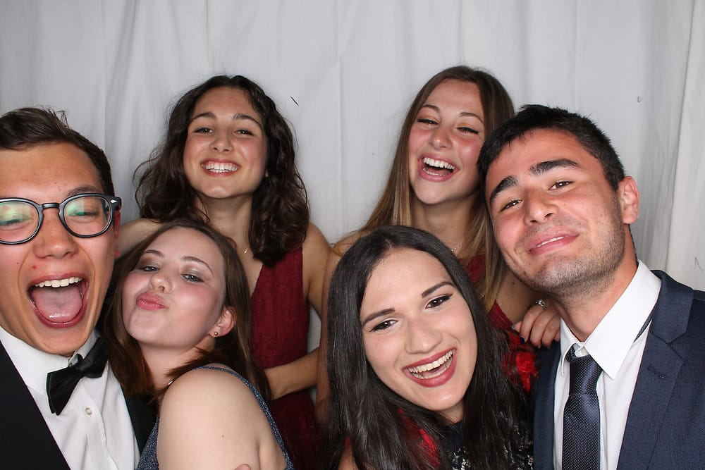
School prom

Slide 8
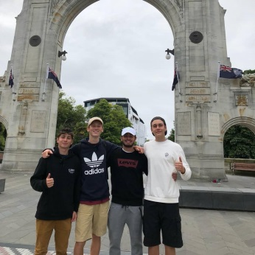
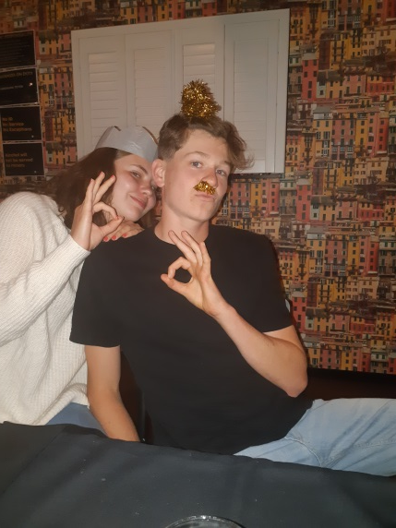
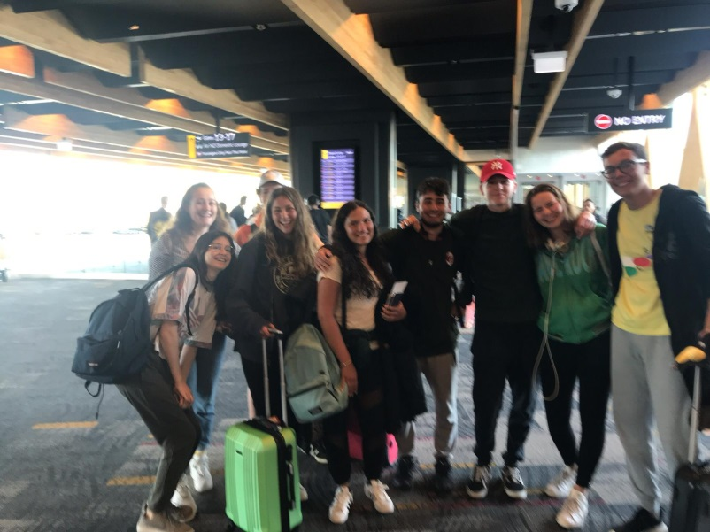
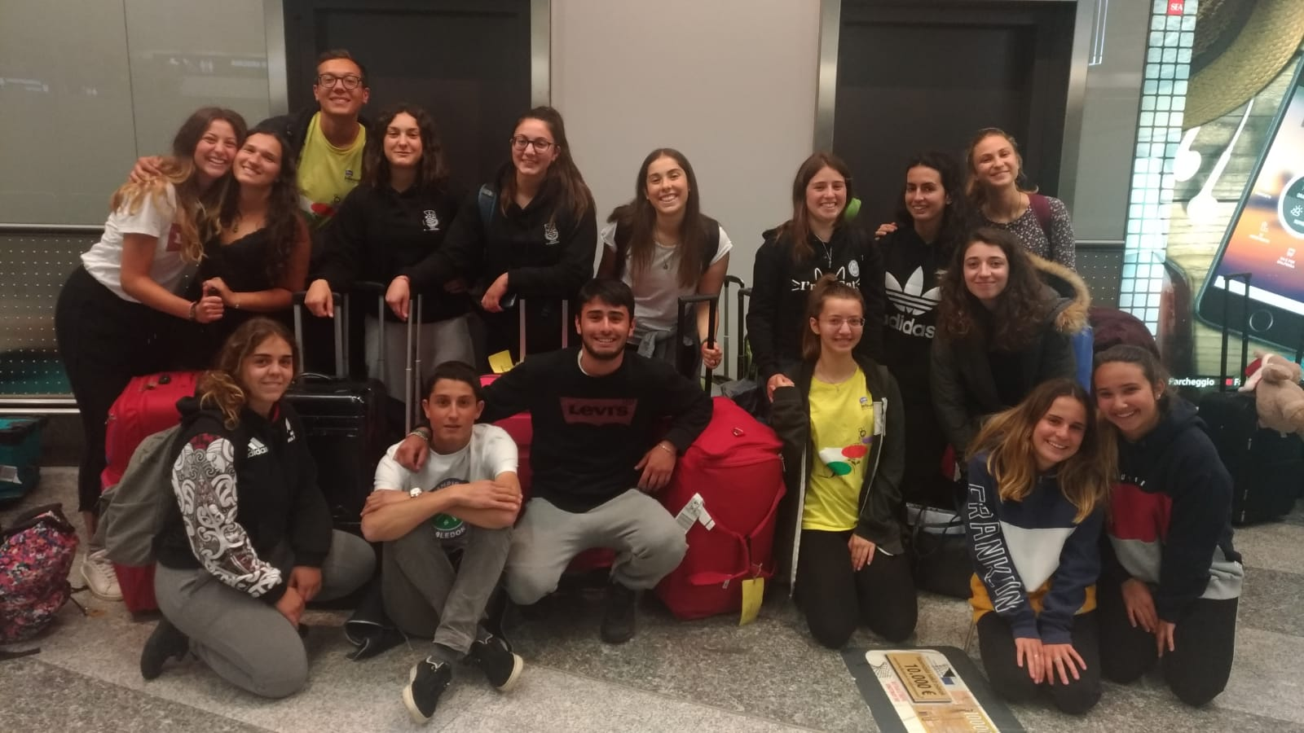
Last days in NZ
How I was feeling? How I said the last goodbyes?
My last trips

Slide 9
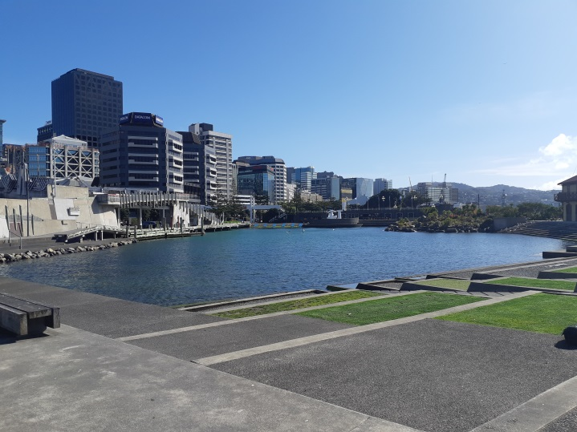
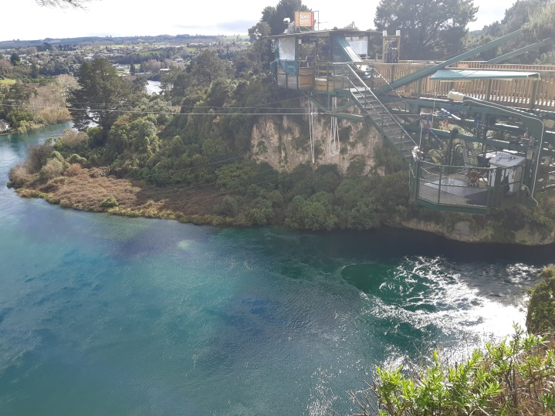
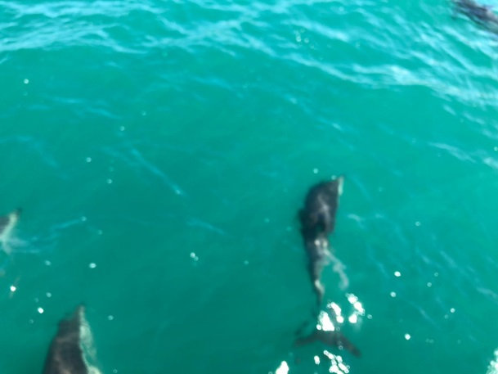
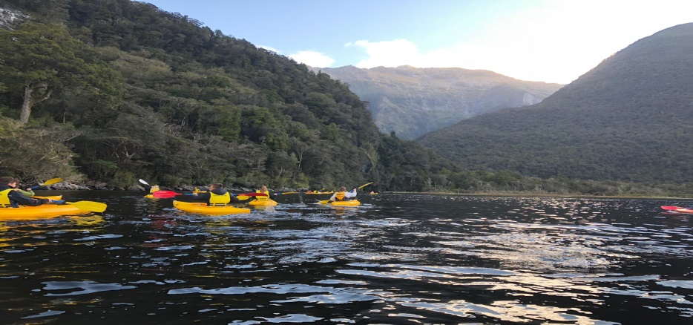
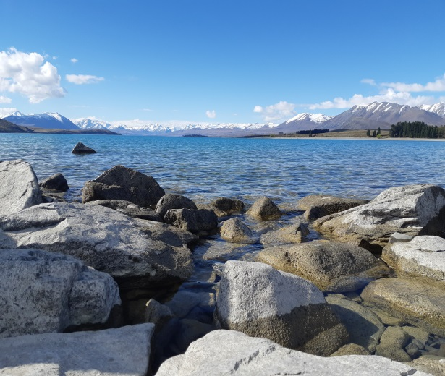
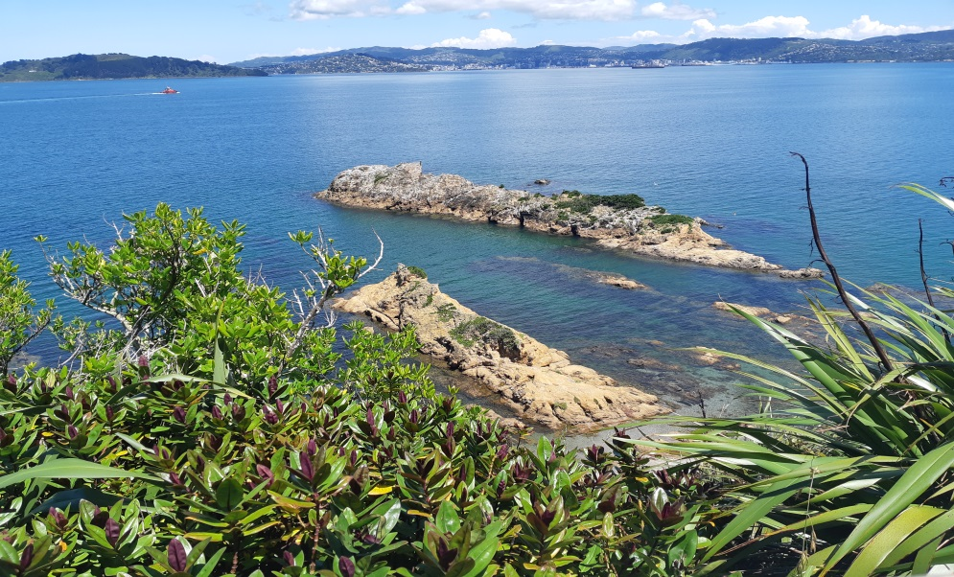
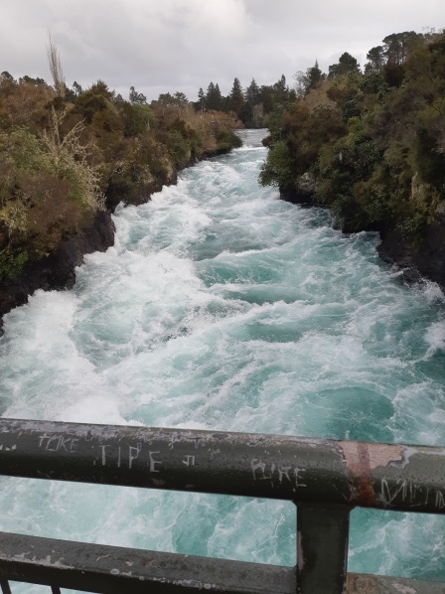
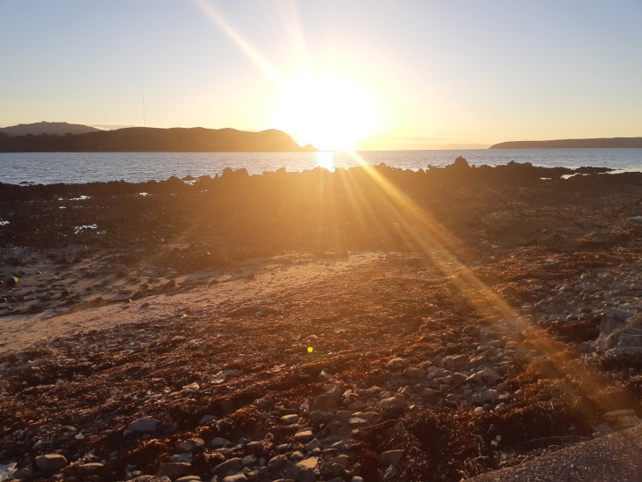
AOTEAROA

